Slide 1
1919Review.wordpress.com
Revolution Under Siege 11: Warlords of Siberia
Perm
December 1918:
Whites seize the city in the ‘Perm Catastrophe’
3rd Army
Siberian Army
General Gajda - @45,000
2ndArmy
Eastern Army Group
84,000 armed
18,000 armed in rear military districts
Western Army
General Khanzhin - @42,000
Ufa
Falls to Whites in March 1919 during Spring Offensive
5th Army
4th Army
Southern Army Group
Dutov / Belov -@25,000
Ural Mountains,
Early 1919
1st Army
Orenburg & Ural Cossacks
@20,000
Orenburg
Worker militia holds out under long siege

Slide 2
1919Review.wordpress.com
Revolution Under Siege 15: Terror on the Don
^ Moscow & Petrograd
Kharkiv
R. Volga
R. Don
Orenburg
Donbass Region
Vyoshenskaya Rebellion
15-30,000 Don Cossacks. From 11 March
Tsaritsyn
Red Southern Front
120,000 soldiers,500 artillery,2,000 machine-guns (Jan-Feb 1919)
Astrakhan
Don Army (AFSR)
15,000 Don Cossacks
Caspian Sea
Sea of Azov
Volunteer Army (AFSR)
@35,000 soldiers
Key
South Russia,
Early 1919
R. Kuban
Ekaterinodar
Advances
Red Caspian-Caucasus Army Group
@150,000 soldiers
Destroyed in Jan-Feb 1919 by Volunteer Army
Forces
Black Sea
Local uprisings

Slide 3
South-West Ukraine, Early 1919
Transnistria & Moldova
Tiraspol
Mikolayiv
R. Dnipro
French & Allied armies
Kherson
Odesa
R. Dnister
Romania
Galaţi
French Navy
Crimea
Sevastopol
Black Sea
1919Review.wordpress.com
Revolution Under Siege 16: The Black Sea Revolt

Slide 4
Ukraine, May 1919
Kyiv
Poltava

Uman


Red Ukrainian Front (total)
70,000
186 artillery
1050 machineguns
14 armoured trains
15 aircraft


Trans-Dnipro Brigade
Nikifor Grigoriev, 15,000-20,000
53 artillery, 500 machineguns, 7 armoured trains
Kropyvnytsi
Dnipro
Key
Kriviy Rih
Grigorievite
Red
Pogrom
R. Dnipro
Mikolayiv

Odesa
Kherson
1919Review.wordpress.com
Revolution Under Siege 17: Anarchy in the Ukraine

Slide 5
1919Review.wordpress.com
Revolution Under Siege 18: The Chelyabinsk Trap
Perm
Red Cavalry
3rd Army
Northern Shock Group
16,000
Chelyabinsk
Ufa
Holding Force
4,500
Red Fifth Army
32,000
Southern Shock Group
10,000
Ural Mountains,
July 1919

Slide 6
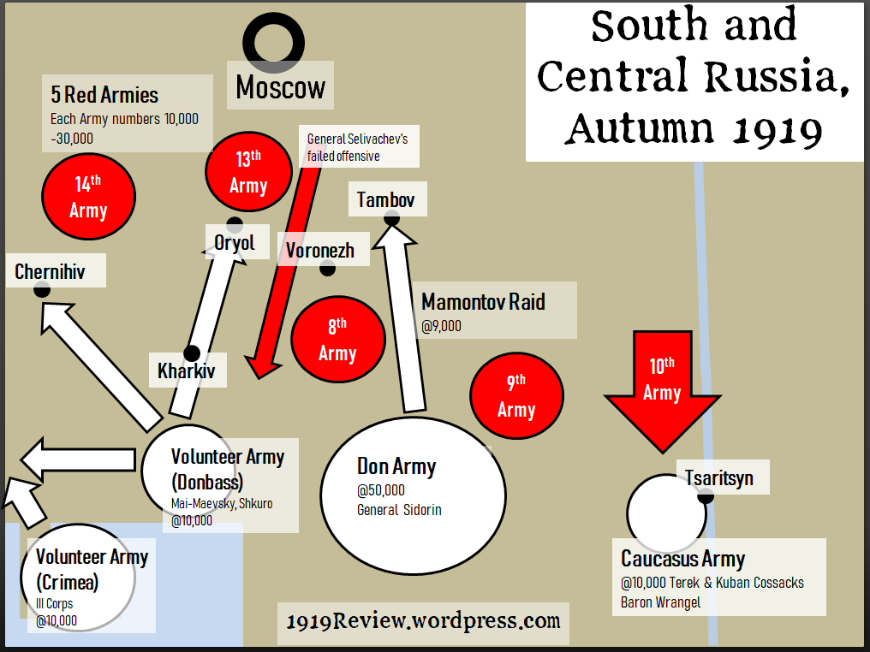
1919Review.wordpress.com
Revolution Under Siege 19: ‘To Moscow!’

Slide 7
Gulf of Finland, October 1919
White Finland
25,000 soldiers facing Russia
Helsinki
Finnish Guerillas
British Naval Forces
Kronstadt
Baltic Fleet
Petrograd
Krasnaya Gorka
Estonian Army
75,000 in total
7th Red Army
40,000, not all armed
North-West Army
18,500 combat troops
50,000 total
Reinforcements
1919Review.wordpress.com
Revolution Under Siege 20: The Battle of Petrograd

Slide 8
1919Review.wordpress.com
Revolution Under Siege 21: Red Cavalry
Moscow
South and Central Russia,
Oct-Nov 1919
First Cavalry Corps
Budennyi
10-15,000
Striking Group
Red Estonians
Latvian Rifles
Tula
Oryol
Chernihiv
Voronezh
Volunteer Army
Don Army
Tsaritsyn
Kharkiv
Anarchists
Makhno
White Rear Garrisons
Taganrog
Caucasus Revolt

