Slide 1
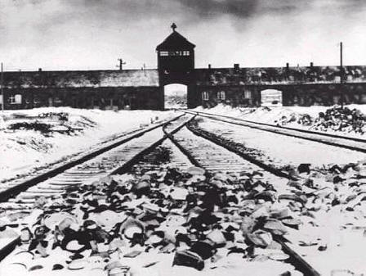
Timeline: Hitler and the Nazis
1919: Hitler joins the Nazi Party
1921: Hitler becomes leader (“Fuhrer”) of the Nazi Party
1923: Beer Hall Putsch ends in disaster
1924: Hitler in prison for 10 months. Writes My Struggle (Mein Kampf)
1929: The Great Depression strikes Germany
1930: Nazis gain 18% of the vote
1932: Nazis gain 37% of the vote
1933: Hitler becomes Chancellor (President) of Germany

Slide 2
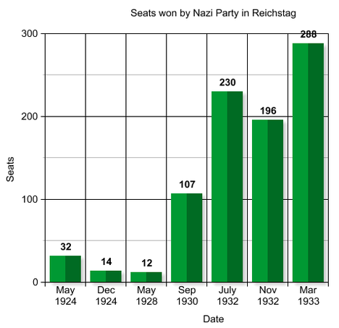
Take down this table
Why did the Nazis have little support in the 1920s?
Why did their support increase in 1930?

Slide 3
In this clip, we will see the events of the Beer Hall Putsch, when the Nazis tried to take power in 1923.
(Clip from Hitler: The Rise of Evil)

Slide 4
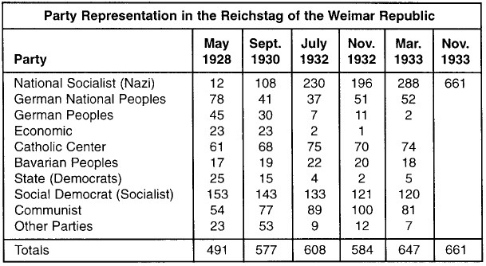
Blue – right-wing parties
Red – left-wing parties
Brown – Nazi party (extreme right-wing)

Slide 5
Adolf Hitler
Fuhrer (leader)
Hermann Goering
2nd in command
Ernst Rohm
Leader of the Stormtroopers (SA)
Joseph Goebbels
Chief of propaganda
Stormtroopers (SA)
Schutzstaffel (SS)
Hitler Youth
League of German Maidens

Slide 6
After the Night of the Long Knives:
Adolf Hitler
Fuhrer (leader)
Hermann Goering
2nd in command
Ernst Rohm
Leader of the Stormtroopers (SA)
Joseph Goebbels
Chief of propaganda
Stormtroopers (SA)
Schutzstaffel (SS)
Hitler Youth
League of German Maidens

Slide 7
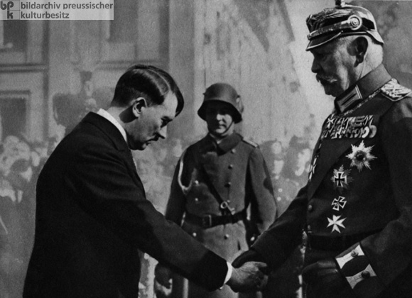
Other politicians agreed to make Hitler Chancellor because they thought they would out-smart him later on and get rid of him. However, as soon as Hitler was in power, he made sure he stayed there.
List 4 ways that Hitler managed to hold onto power.

Slide 8
Other politicians agreed to make Hitler Chancellor because they thought they would out-smart him later on and get rid of him. However, as soon as Hitler was in power, he made sure he stayed there:
Rule by decree, not through parliament
Reichstag Fire
(excuse)
Communist Party banned
Nazi control of police
Trade unions destroyed
Night of the Long Knives
SA and SS violence
Chancellor and President combined into Fuhrer

Slide 9
Features of Nazi rule in Germany, 1933-1939
Terror
Propaganda
Economic Policies
Josef Goebbels controlled newspapers, film, and radio
Strict censorship
Nuremberg rallies every year
“People’s Receiver” radio set
Anti-Semitic and racist propaganda

Slide 10
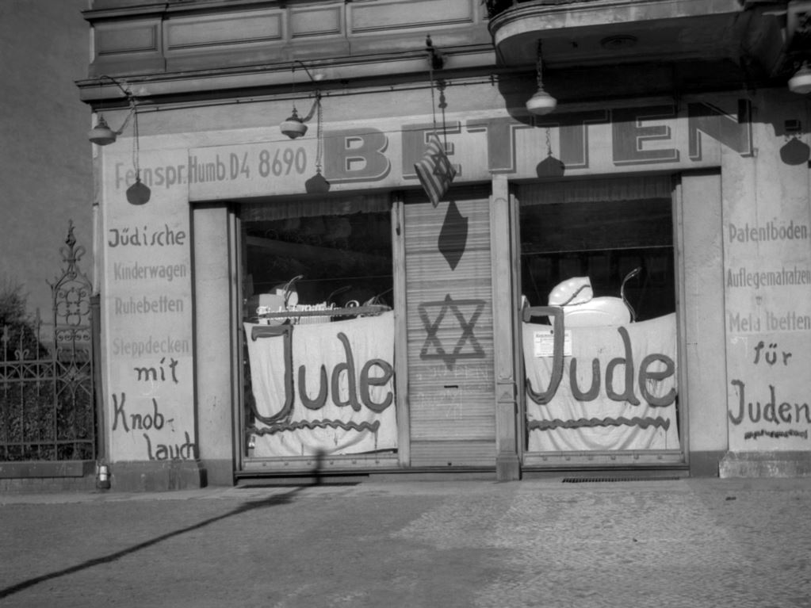
Results of Nazi Anti-Semitism, 1933-1939

Slide 11
Results of Nazi Anti-Semitism, 1933-1939
Many Jews were boycotted, sacked, beaten up, threatened, imprisoned or killed.
Of 500,000 Jews in Germany, 282,000 left between 1933 and 1939.
Other countries often refused to allow them in, or treated them poorly.
In the 1940s, the Holocaust began – which we will study properly in future classes.

