Slide 1
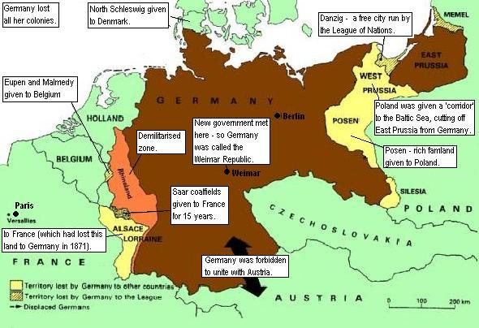
Germany after World War One
The Treaty of Versailles imposed harsh conditions on Germany.

Slide 2
France
Germany
Reparations payments
€€€€€€€€€€€€€€€€€€

Slide 3

NO troops in the Rhineland
ONLY 100,000 soldiers allowed in the German army

Slide 4
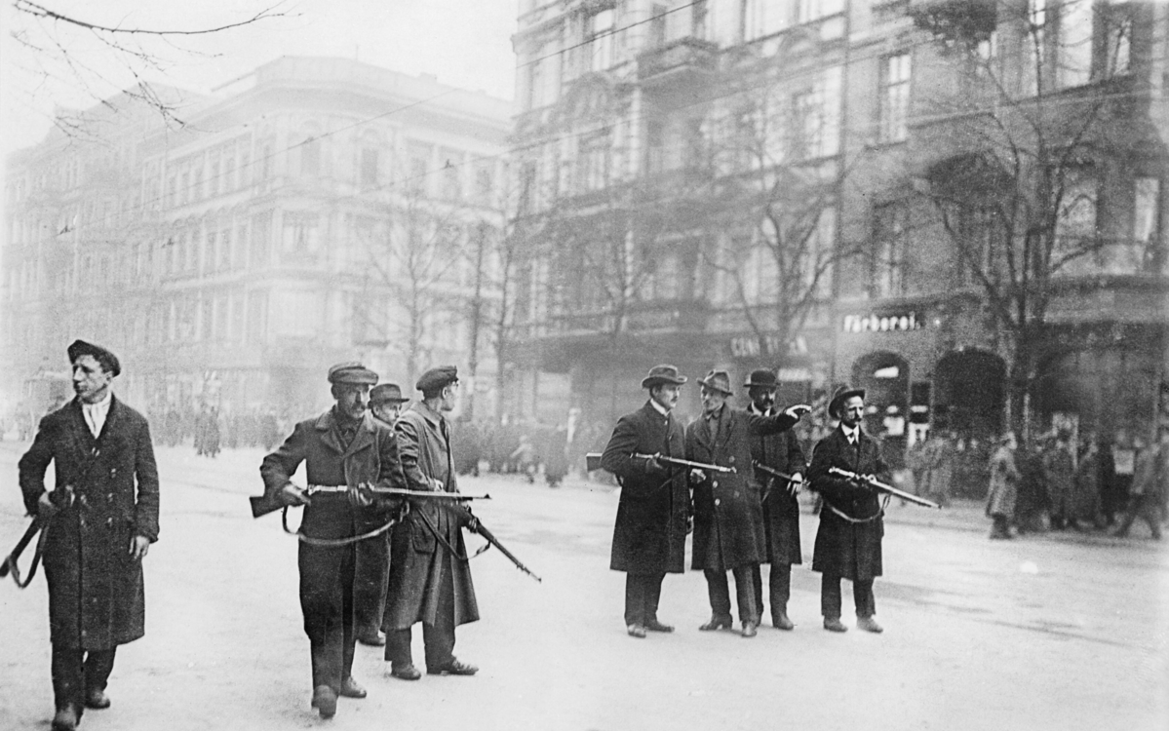
Revolution
In 1918 the Kaiser (King) was overthrown. A Republic was established. The parliament met in a small remote town called Weimar, not in Berlin – so it was known as the Weimar Republic.
There were attempts at Socialist Revolution, like in Russia:
The Spartacus Uprising, 1919 (pictured).
The Bavarian Socialist Republic, 1919.
Attempted Communist Party uprisings in 1920 and 1923.

Slide 5
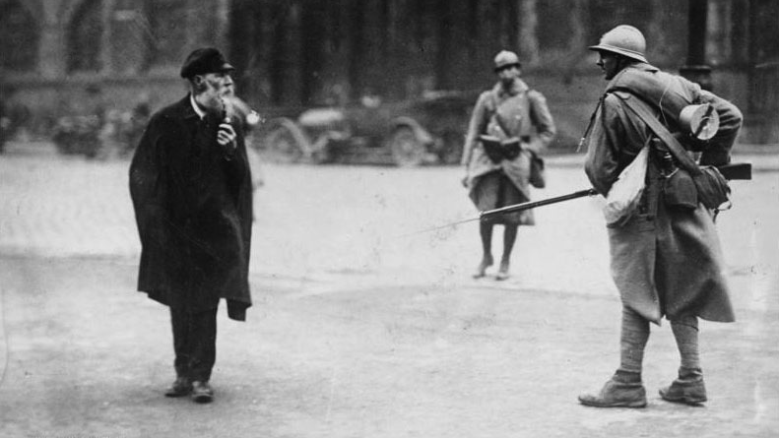
The Ruhr Occupation
In 1923 Germany was unable to keep up with its reparations payments. To punish the German people, the French and Belgian armies occupied the Ruhr, an industrial area of Germany. They seized resources and products to send home. 132 Germans were killed and 150,000 driven out of the Ruhr area.

Slide 6
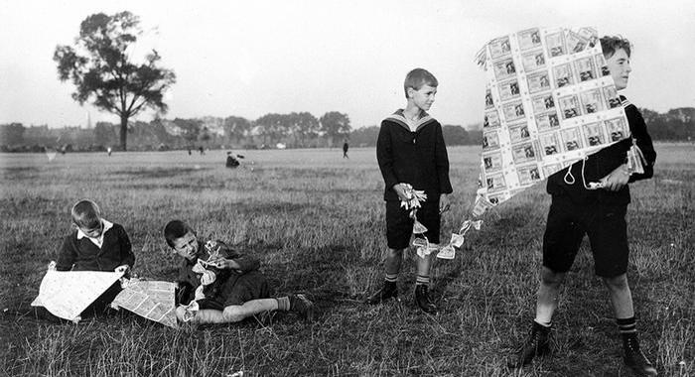
Hyper-inflation
Thanks to reparations payments and the Ruhr Occupation, Germany suffered huge economic problems. In 1923 inflation went out of control, until German currency was practically worthless. According to the BBC, ‘a loaf of bread, which cost 250 marks in January 1923, had risen to 200,000 million marks in November 1923.’

Slide 7
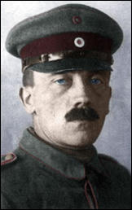

Slide 8
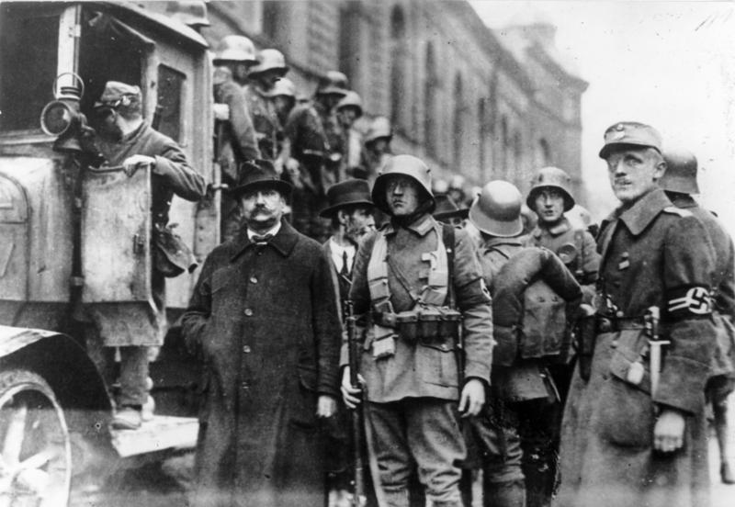

Slide 9
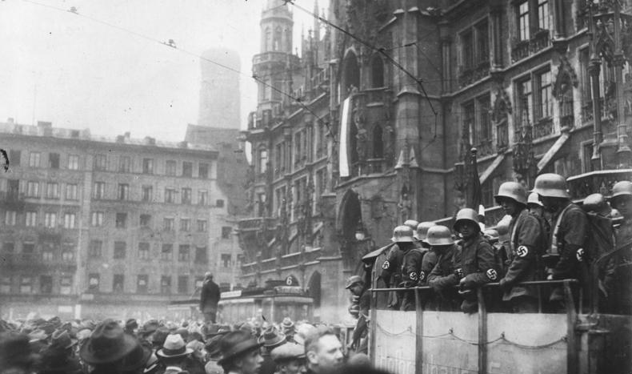

Slide 10
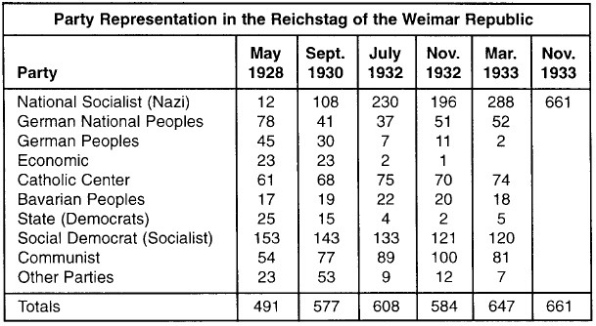
Election results, 1928 – seats in the Reichstag

Slide 11
Hitler and the Nazis – Timeline
Fill in the following timeline using information from the document ‘How the Nazis took power, 1 of 3’.
1889
1914-1918
1919
1923
1924
1925
1928

Slide 12
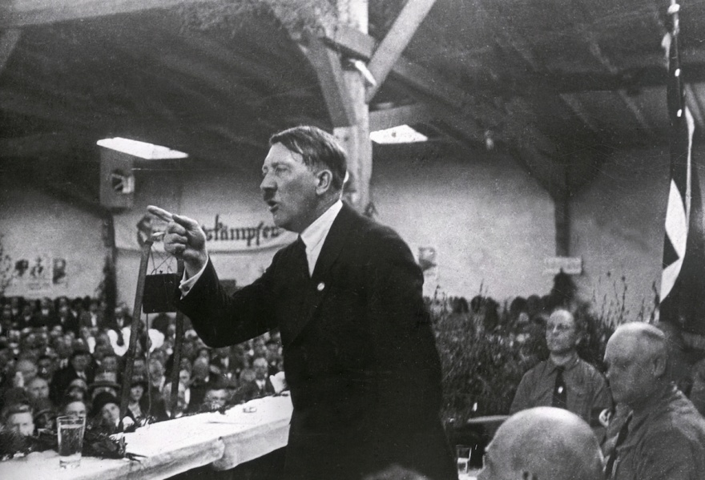
Hitler’s views:
Jews to blame for economic problems.
Modernity and democracy are a source of weakness.
We will return to former glories – Germany was once powerful. We will become even more powerful than before.

Slide 13
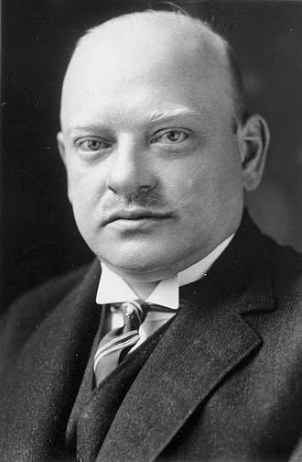
The main politician in Germany in the 1920s was Gustav Stresemann. He served as Chancellor and Foreign Minister.
In 1924 he negotiated the Dawes Plan with the United States.
The Dawes Plan was a loan agreement that
helped Germany to pay the reparations
helped to end the hyperinflation.
The economy improved. 1920s Germany, known as the Weimar Republic, was a centre of culture and technology.

Slide 14
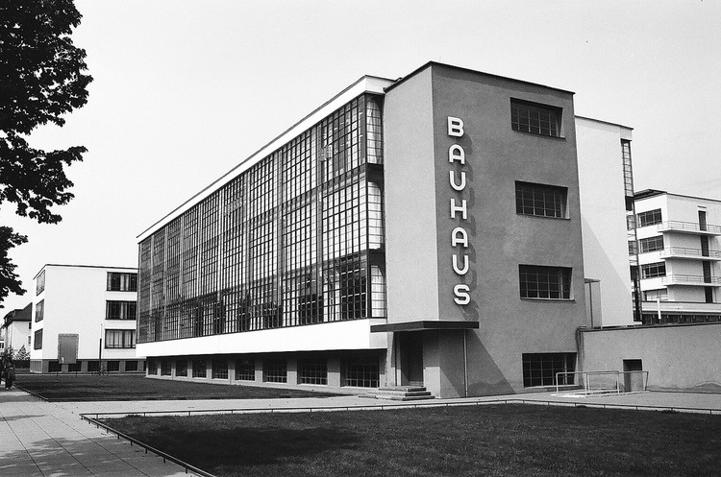

Slide 15
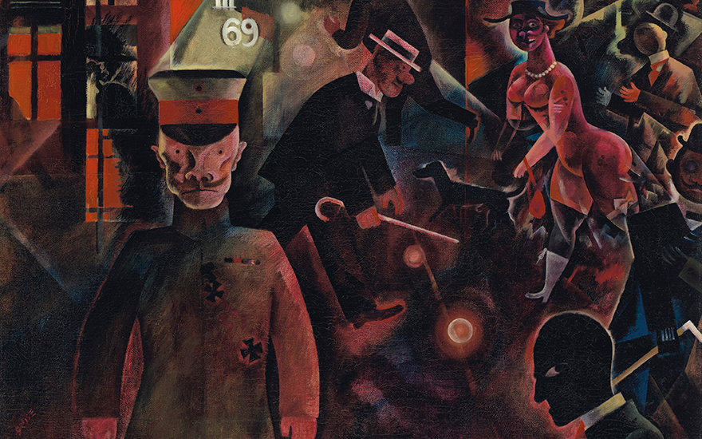
George Grosz

Slide 16
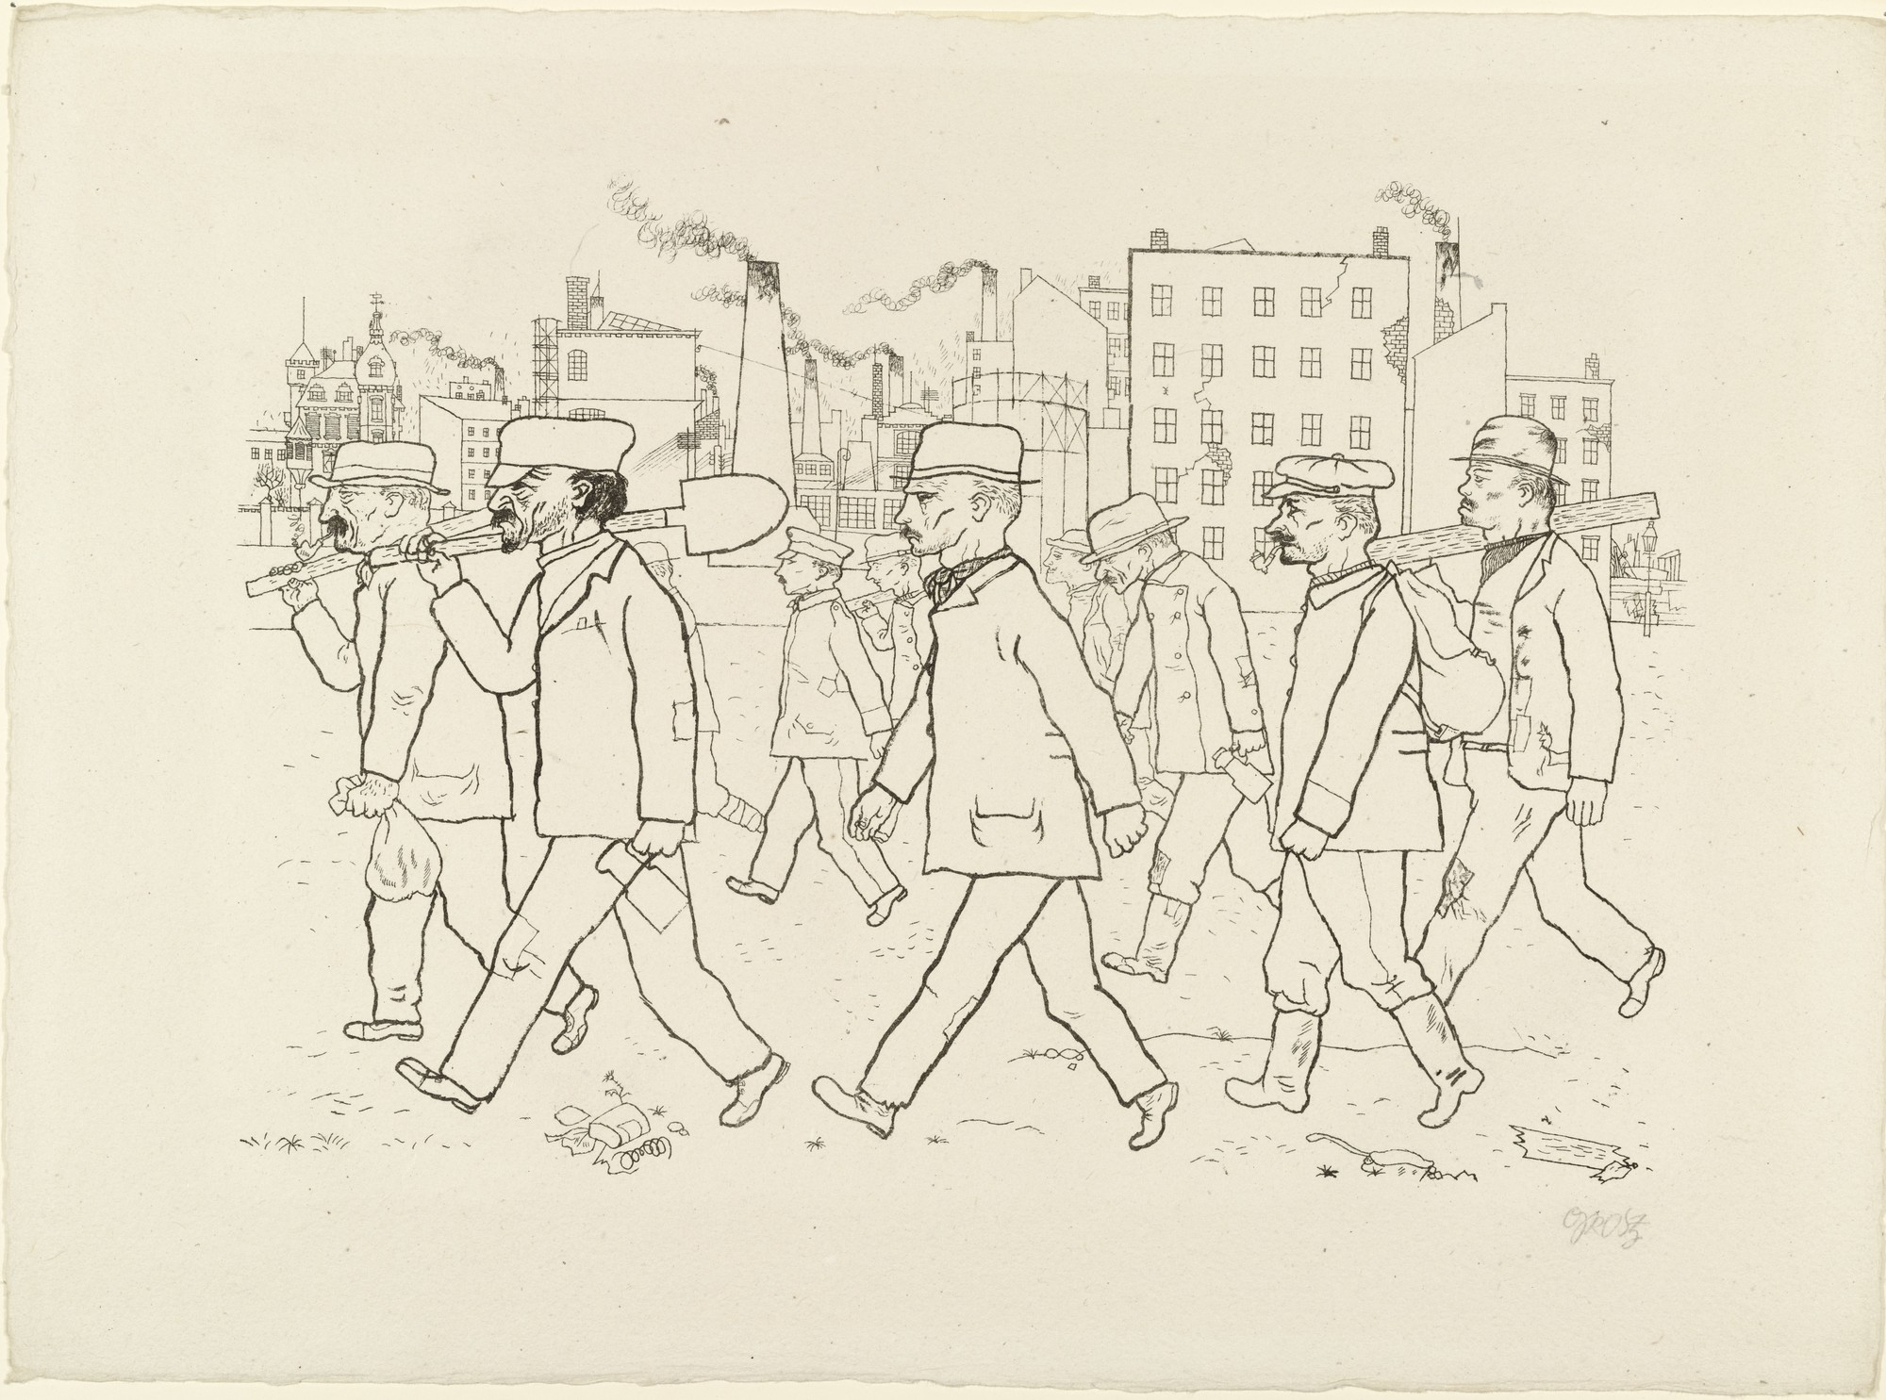
George Grosz

Slide 17
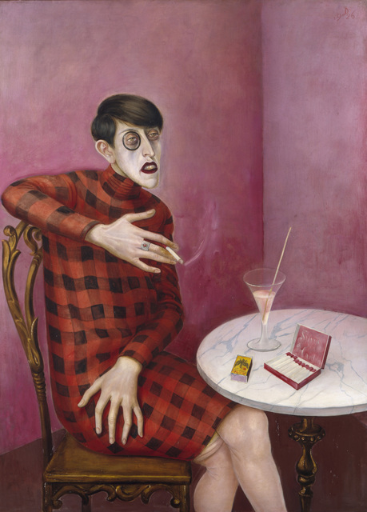
Otto Dix

Slide 18
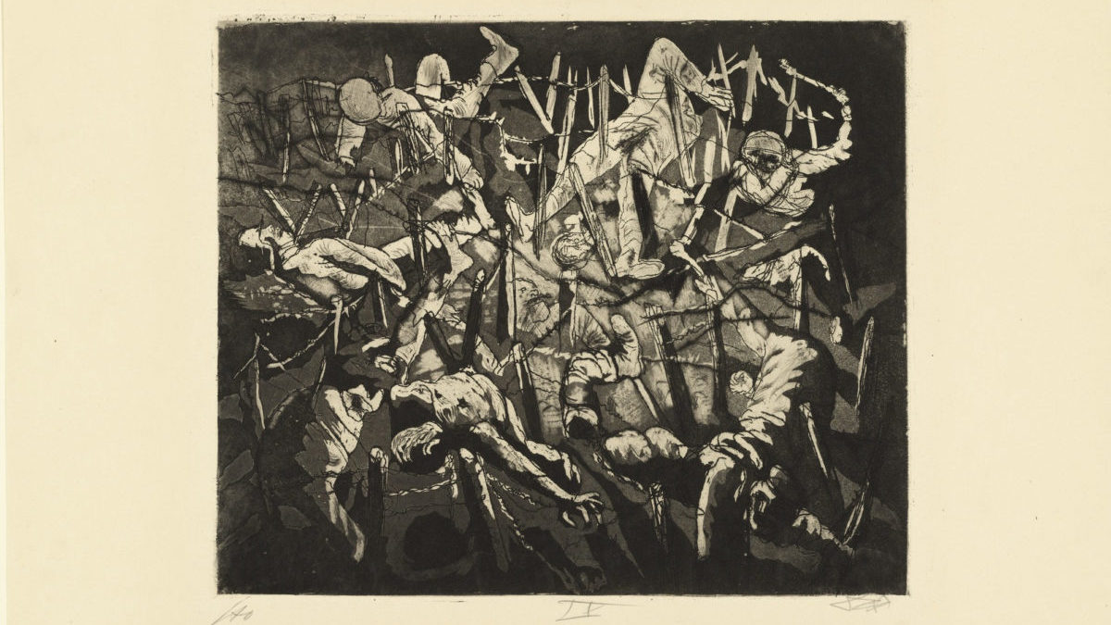
Otto Dix

Slide 19
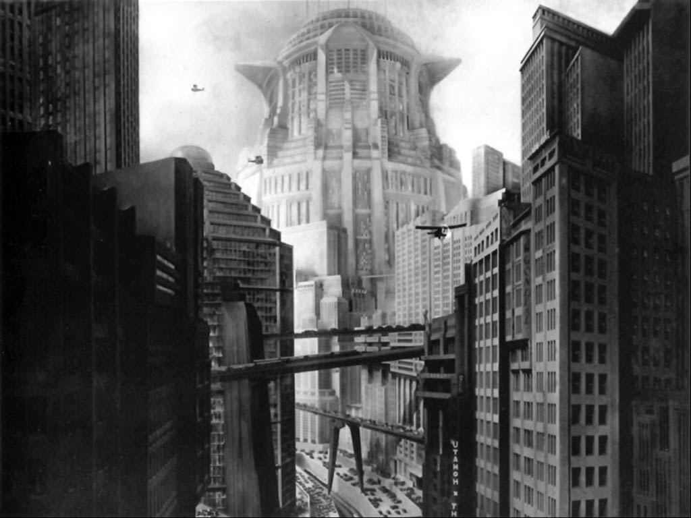
From the film Metropolis directed by Fritz Lang

Slide 20
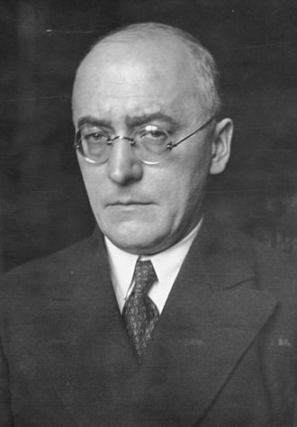
In 1929 Stresemann warned:
‘Germany is in fact dancing on a volcano. If the short-term loans are called in by America, a large section of our economy would collapse.’
Later that year Stresemann died. Just three weeks after his death, this warning came true.
The Wall Street Crash occurred in October 1929, kicking off the Great Depression, a worldwide economic crisis that lasted for ten years.
It hit Germany particularly hard. As Stresemann warned, the loans were called in.
Heinrich Bruning, who led Germany from 1930 to 1932, was known as the Hunger Chancellor because of his regime of strict austerity (tight credit and pay cuts).
Heinrich Bruning

Slide 21
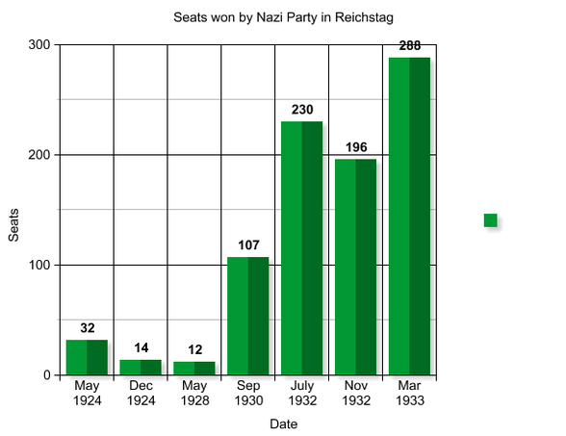

Slide 23
The Nazi Party
Adolf Hitler
Leader
Key Beliefs:
Anti-Semitism
Anti-Communism
Nationalism
Imperialism
Ernst Rohm
Leader of the Stormtroopers
Publications:
Volkischer Beobachter, the newspaper of the Party
Mein Kampf, Hitler’s book
Josef Goebbels
In charge of Propaganda
Hermann Goering
Ex-fighter pilot

Slide 24
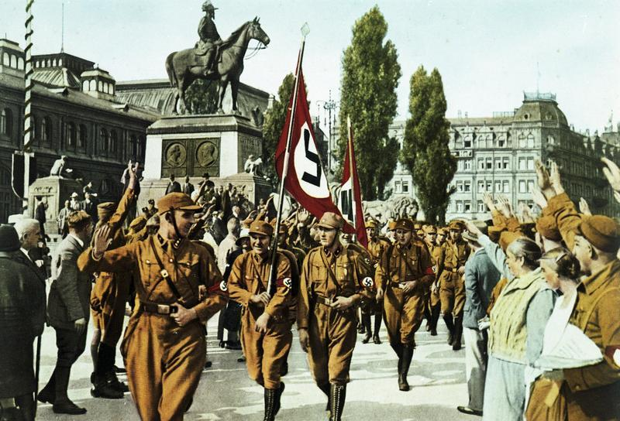
Horst Wessel and some of his Brownshirt comrades

Slide 25
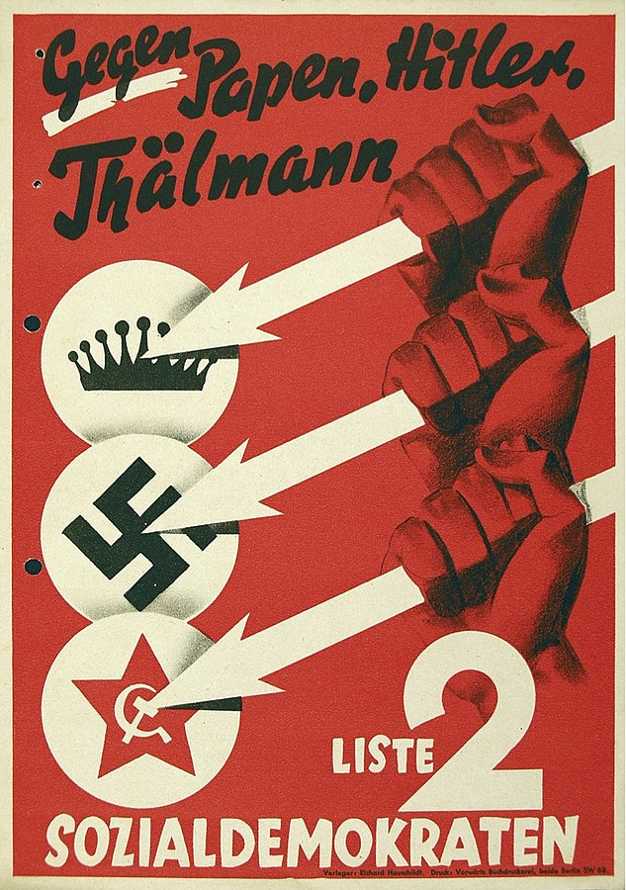
An election poster for the social democrats using the ‘Three Arrows’ motif

Slide 26
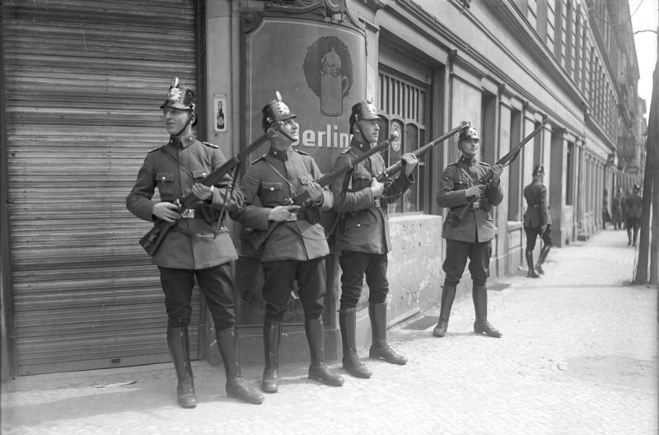
Berlin police during ‘Bloody May’ 1929

Slide 27
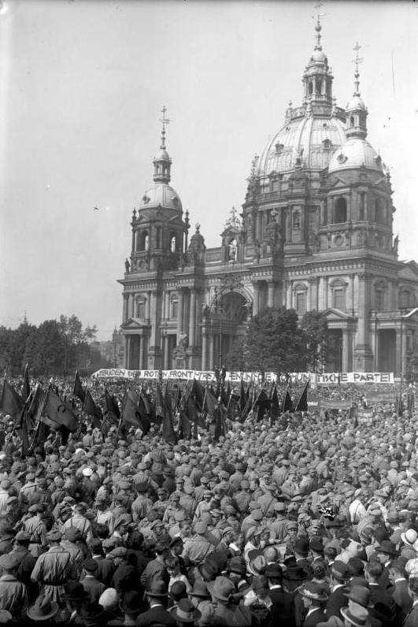
A mass meeting of the Red Front-Fighters’ League

Slide 28
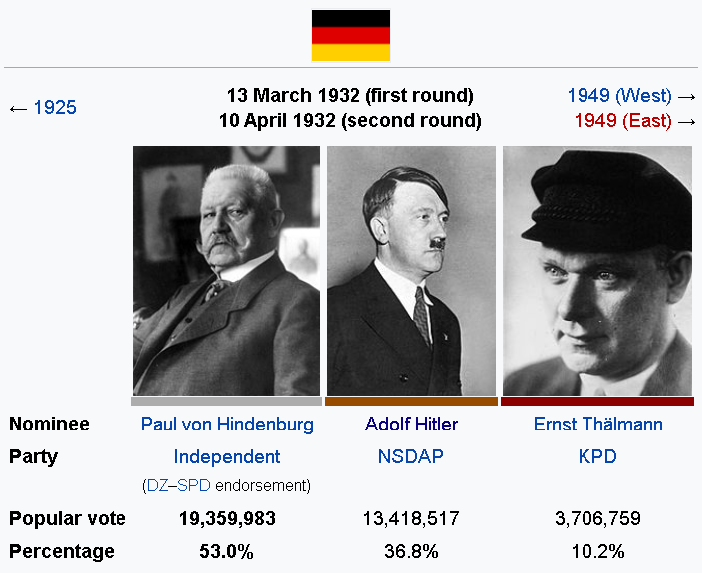
From Wikipedia.org

Slide 29
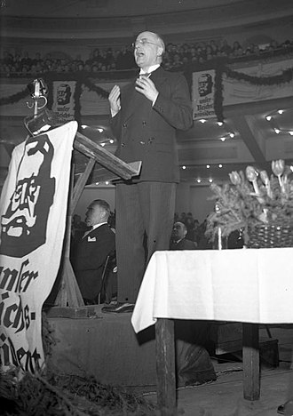
Bruning speaks at a rally in favour of Hindenburg during the 1932 presidential election.

Slide 30
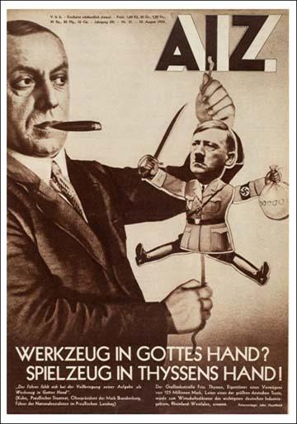
Workers’ Illustrated Newspaper, a pro-communist publication. The cover photomontage is typical of Weimar art. It is by John Heartfield, who was a collaborator of George Grosz and of Bertold Brecht.
The caption reads, ‘A tool in God’s hand? A toy in Thyssen’s hand!’

Slide 31
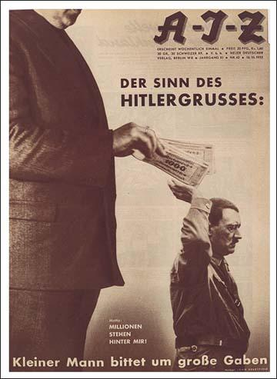
Another John Heartfield photomontage. Caption: ‘The little man asks for big gifts’

Slide 32
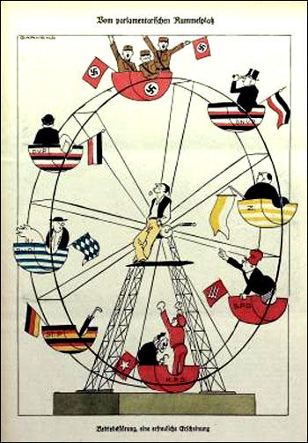
A cartoon by Oskar Garvens shows the various political parties going in and out of government.

Slide 33
The rise of power of the Nazis
Street Violence
Stormtroopers v Red Front Fighters’ League
Horst Wessel
Performance in elections
Manouevres by the political parties
Divided Opponents
Effects of the Great Depression
From 1.25 to 4 million unemployed
Any other factors?

