Slide 1
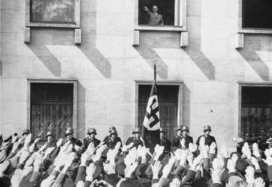
The Nazis in Power

Slide 2
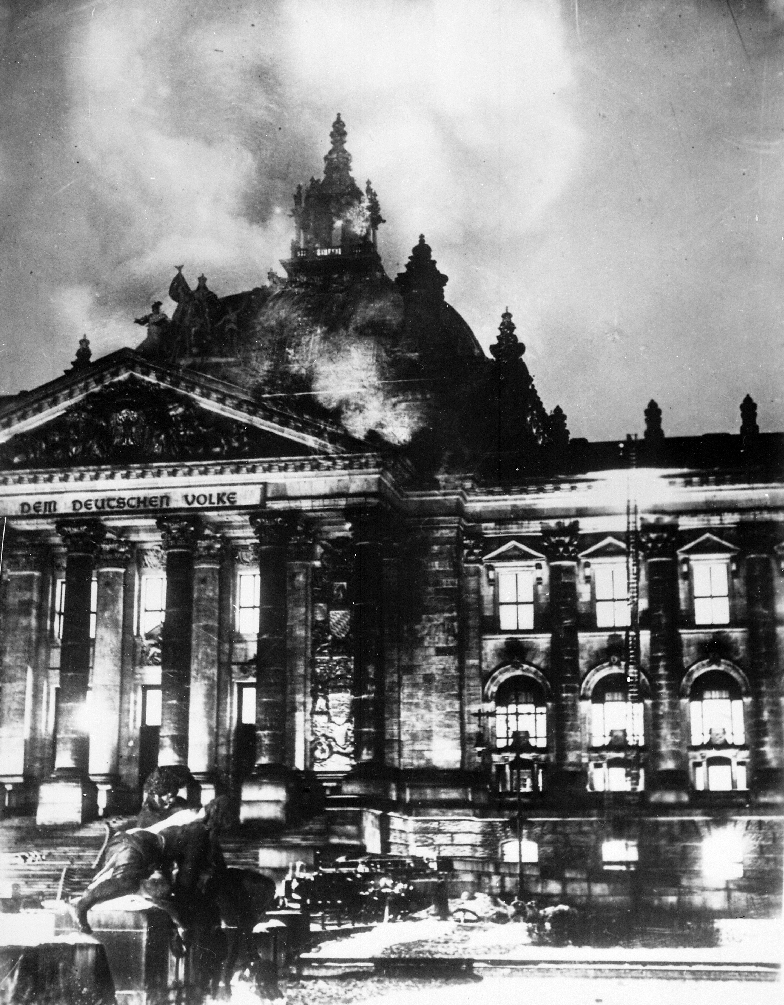

Slide 3
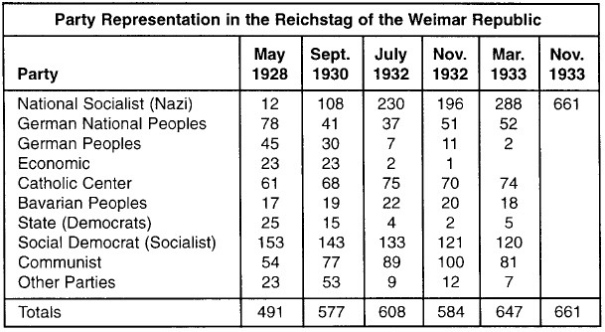
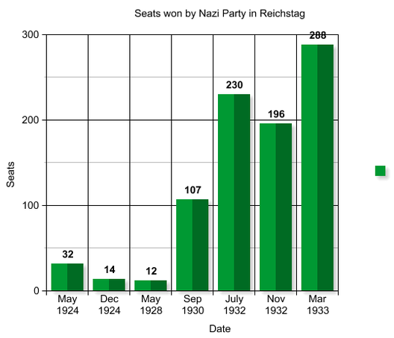

Slide 4
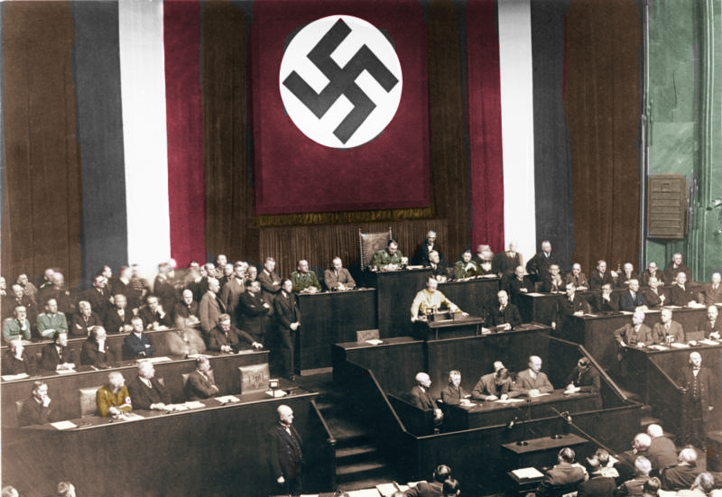
The Enabling Act

Slide 5
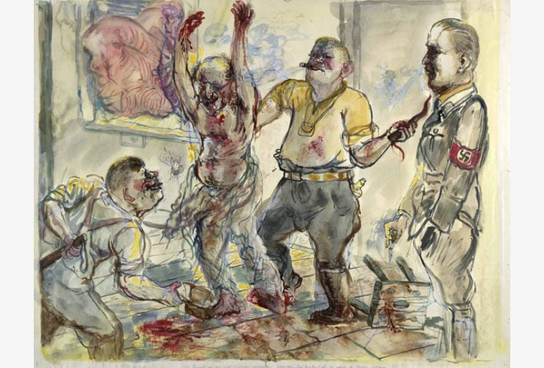
‘Interrogation’ by George Grosz

Slide 6
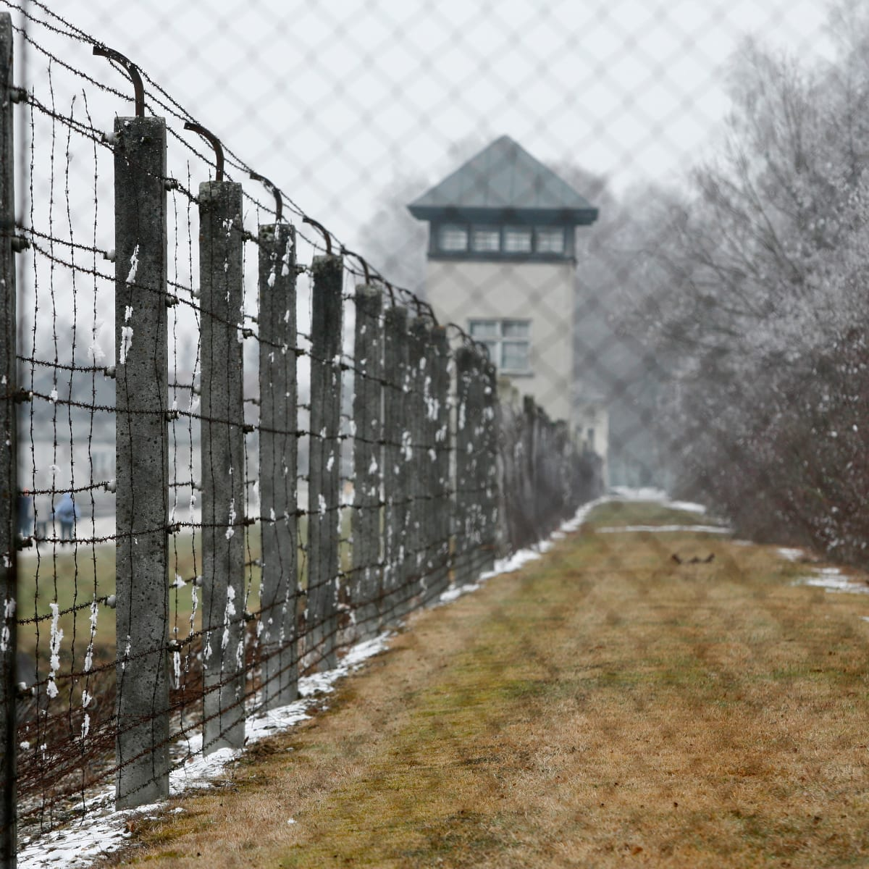

Slide 7
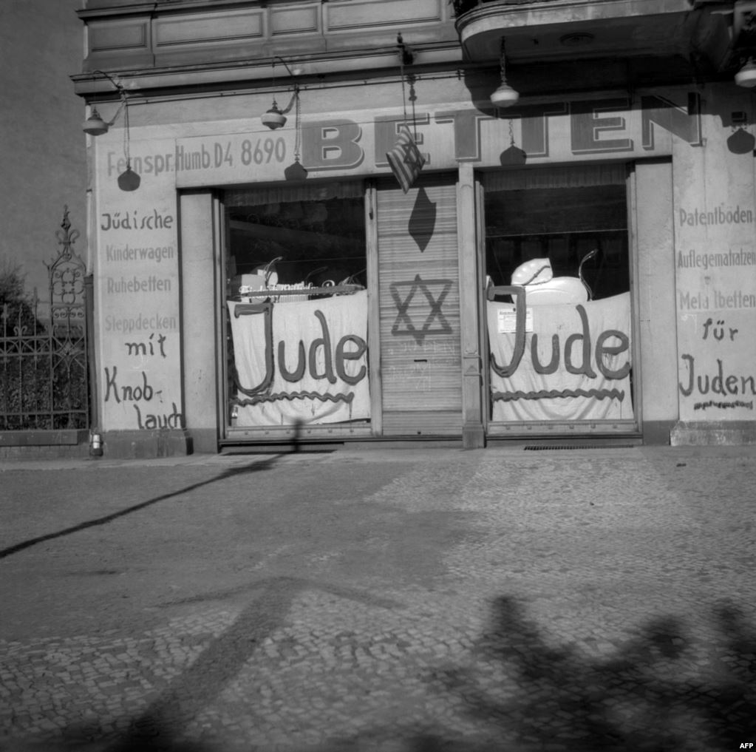

Slide 8
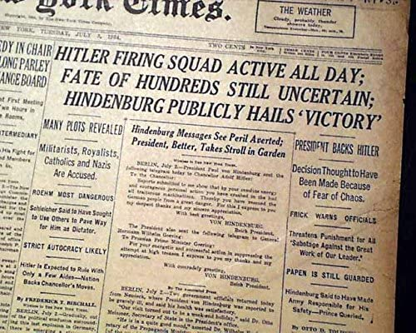

Slide 9
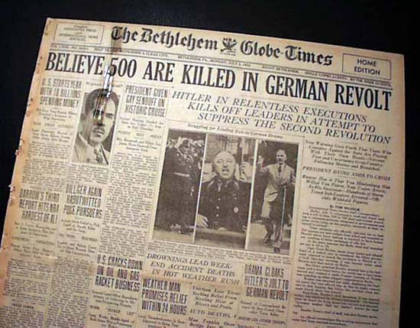

Slide 10
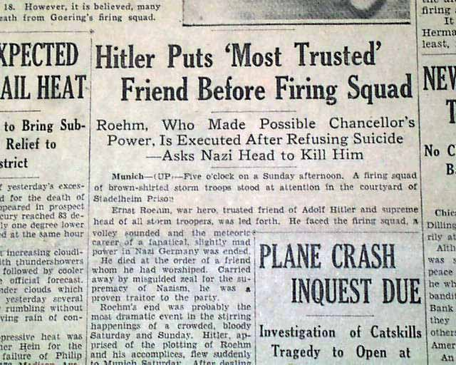

Slide 11
The Night of the Long Knives
When: The night of June 30th-July 1st
What: Hitler’s personal bodyguard, the Schutzstaffel (SS), murdered 400 people
Who: Ernest Rohm, all major leaders of the Stormtroopers, Gregor Strasser (who was the party leader before Hitler), and many generals, communists, social democrats and other critics of Hitler
Why: Hitler claimed they were all plotting against him.
How: Assassinations, arrests, firing squads.

Slide 12
Write a few lines describing each of the following events:
The Reichstag Fire
The Enabling Act
Concentration Camps
The Night of the Long Knives

