Slide 1
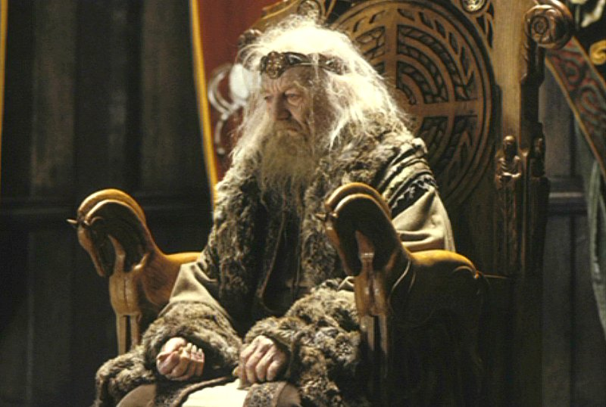
King Lear
Acts 1 and 2

Slide 2
Is Lear King?
I do invest you jointly with my power,
Pre-eminence, and all the large effects
That troop with majesty. Ourself, by monthly course,
With reservation of an hundred knights,
By you to be sustain'd, shall our abode
Make with you by due turns. Only we still retain
The name, and all the additions to a king;
The sway, revenue, execution of the rest,
Beloved sons, be yours.
Cornwall, Regan, Albany and Goneril get all his power, his ability to give orders and his money.
Lear will keep only the name of King, along with 100 knights. Each week a different daughter will put him up in her house.

Slide 3
Save Thee - I hope you’re well
Pray you – please
Perforce – strongly
Intelligence is given – You have been told on
Beget opinion of my more fierce endeavour – give the impression that I was fighting
Parricide – someone who kills their own father
In fine – briefly
Loathly opposite – Very much against
Gasted – scared
A child-like office – duty fitting a son or daughter
Revenues – money
Sojourn – stay, visit

Slide 4
Goneril V Lear
GONERIL
Here do you keep a hundred knights and squires;
Men so disorder'd, so debosh'd and bold,
That this our court, infected with their manners,
Shows like a riotous inn: epicurism and lust
Make it more like a tavern or a brothel
Than a graced palace.
LEAR
Detested kite! thou liest.
My train are men of choice and rarest parts,
That all particulars of duty know,
And in the most exact regard support
The worships of their name.

Slide 5
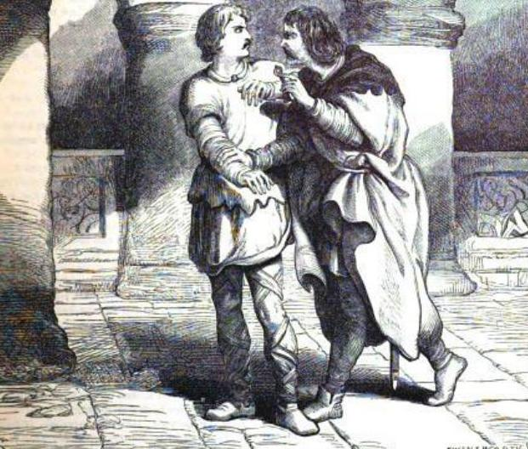
Act 2, Scene 1
Edmund (bastard son of Gloucester) tricks Edgar into running away.
Edmund tells everyone that Edgar was planning to murder Gloucester and blame it on him.
Gloucester makes Edmund his heir, and sends soldiers out to hunt Edgar.
Edmund tricking Edgar.

Slide 6
Questions
P 62, q’s 2, 4, 7
2. Why, do you think, does Edmund describe his brother as “Mumbling of wicked charms, conjuring the moon?”
4. Regan talks of Edgar as Lear’s godson and as a “companion with the riotous knights” who attend on King Lear. What is the significance of these attempts to link Edgar with Lear?
7. Can you find any parallels between Gloucester’s behaviour in this scene and Lear’s behaviour in Act 1 scene 1?

Slide 7
Act 2 Scene 2 – Vocab
Art of this house? – Do you live here?
Mire – swamp
Prithee – please
Use me thus – treat me like this
Knave – a bad person
Draw – take out your sword and fight
His countenance likes me not – I don’t like his face
Stocks – punishment for petty criminals

Slide 8
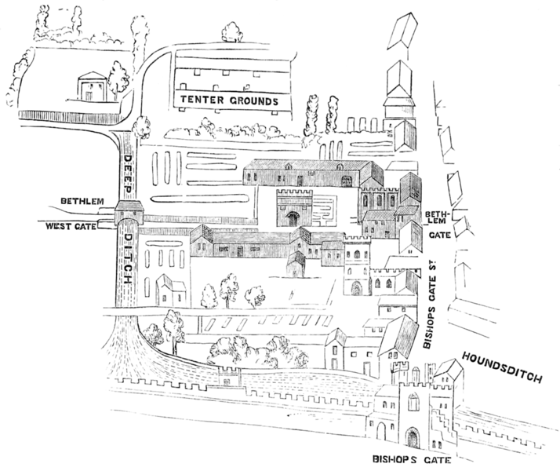
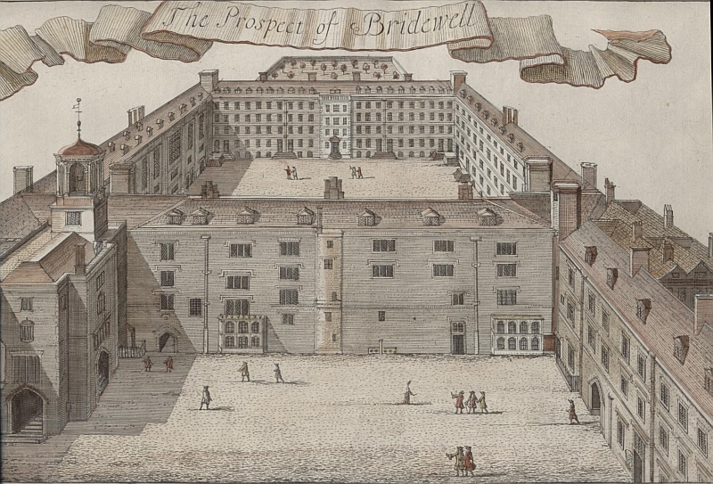
“Bedlam”
Bethlem Royal Hospital was an institution for mentally ill people in London in Shakespeare’s time.
People called referred to madness and mentally ill people as “Bedlam”.
“Tom O’Bedlam” was a kind of nickname for someone who lives on the streets, raving and mentally unstable.

Slide 9
Act 2 scene 3: Vocab
I heard myself proclaimed: I heard people shouting for me
Happy – lucky
Vigilance – look-out
Attend my taking – catch me
Penury – poverty
Enforce their charity – Look for spare change

Slide 10
King Lear has arrived at Cornwall’s castle, expecting a warm welcome.
What does he find instead?
How does he react to this?
What does this surprise show about how King Lear’s circumstances have changed?

Slide 11
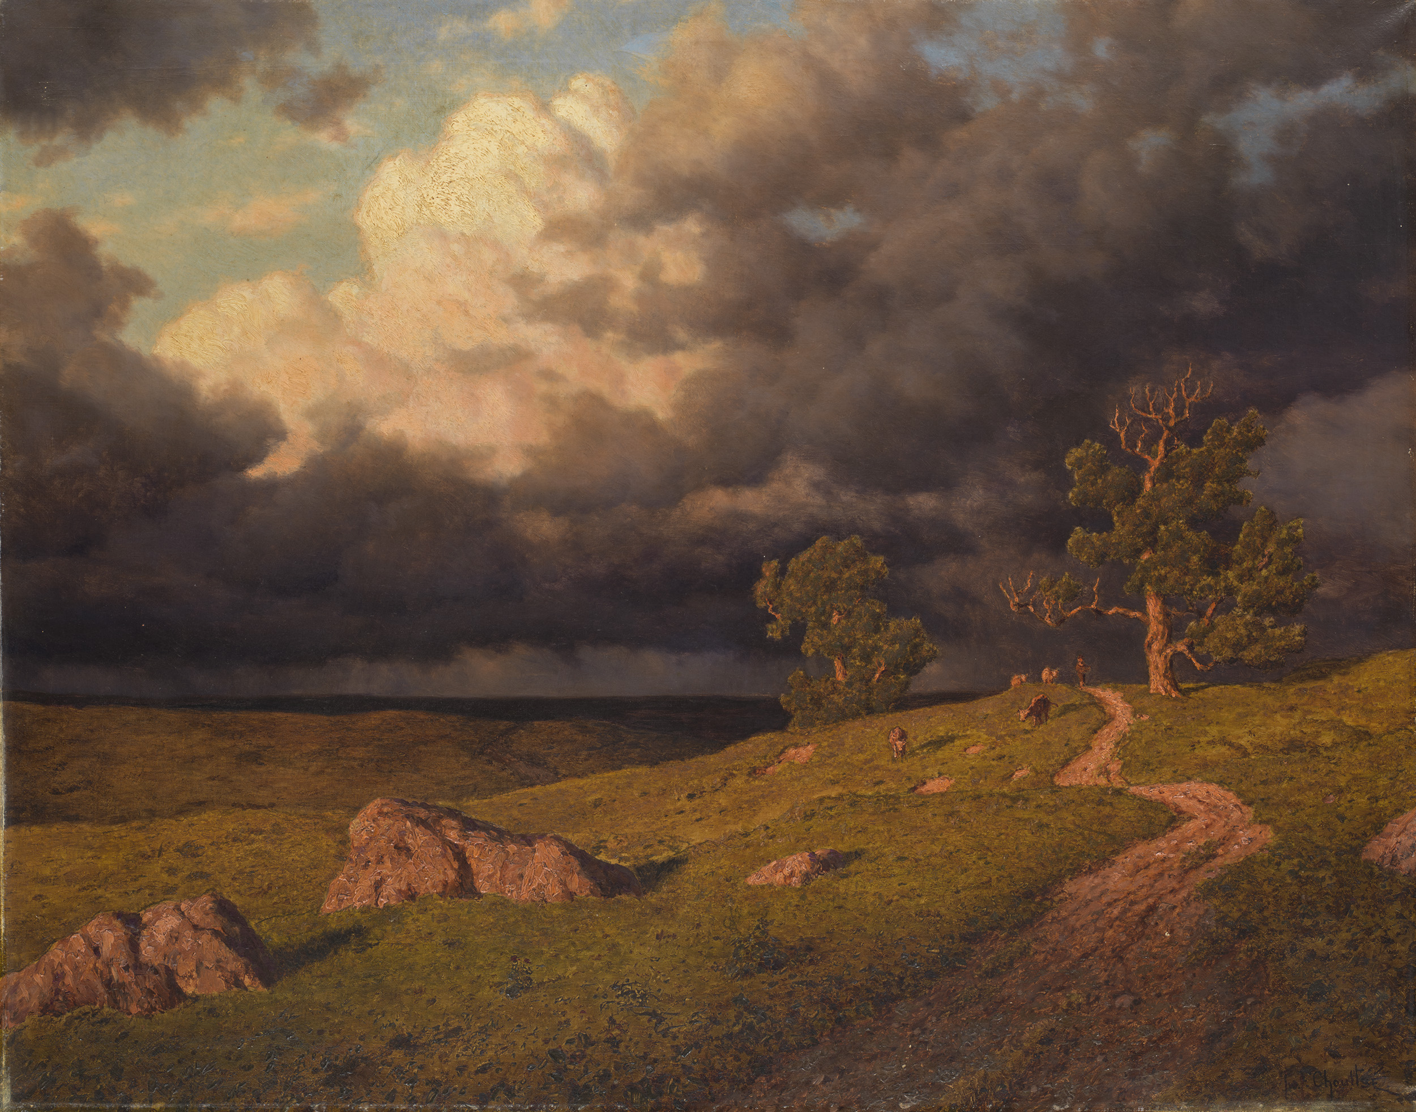
Act 2 scene 4 (Read the notes and take down the vocab and quote)
Goneril shows up. Lear explains to Regan that Goneril drove him out. He hopes for better treatment from Regan.
Regan, too, demands that he cut down his following of 100 knights. Would 25, 10, 5, or even none at all not be enough?
Lear flies into a rage and storms off. They decide to let him sleep out under the sky.
Chide – criticise
Provided – having enough supplies
Amity – friendship
Attendance – service
What need you – why do you need
Regan says that stubborn people get what’s coming to them, and it’s the only way to teach them:
To wilful men
The injuries that they themselves procure
Must be their schoolmasters.

Slide 12
Lear: “O, reason not the need…”
O, reason not the need:
…Allow not nature more than nature needs,
Man's life's as cheap as beast's: thou art a lady;
If only to go warm were gorgeous,
Why, nature needs not what thou gorgeous wear'st,
Which scarcely keeps thee warm. But, for true need,--
You heavens, give me that patience, patience I need!
You see me here, you gods, a poor old man,
As full of grief as age; wretched in both!
If it be you that stir these daughters' hearts
Against their father, fool me not so much
To bear it tamely; touch me with noble anger,
And let not women's weapons, water-drops,
Stain my man's cheeks! No, you unnatural hags,
I will have such revenges on you both,
That all the world shall--I will do such things,--
What they are, yet I know not: but they shall be
The terrors of the earth.
Don’t ask me to explain why I need my knights to live with me!
If everyone gets only what they need and no more, then human life means no more than an animal’s.
You wear fancy clothes all the time. Do you need to? Do fancy clothes keep you warm?
If it was the gods that made my daughters hate me so much, then let me show anger, not sadness. I refuse to cry.
Just you wait, I’m going to get you back for this, I’m going to have my revenge, and it’s going to be so bad… I’m going to… Well, I don’t know yet exactly what I’ll do, but it’s going to be bad!

Slide 13


