Slide 1
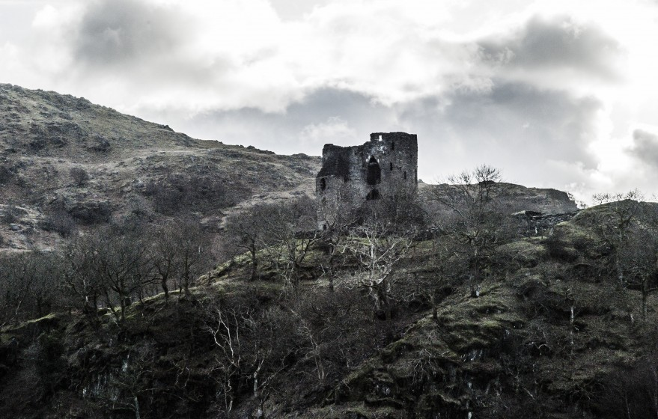
King Lear
Act 3

Slide 2
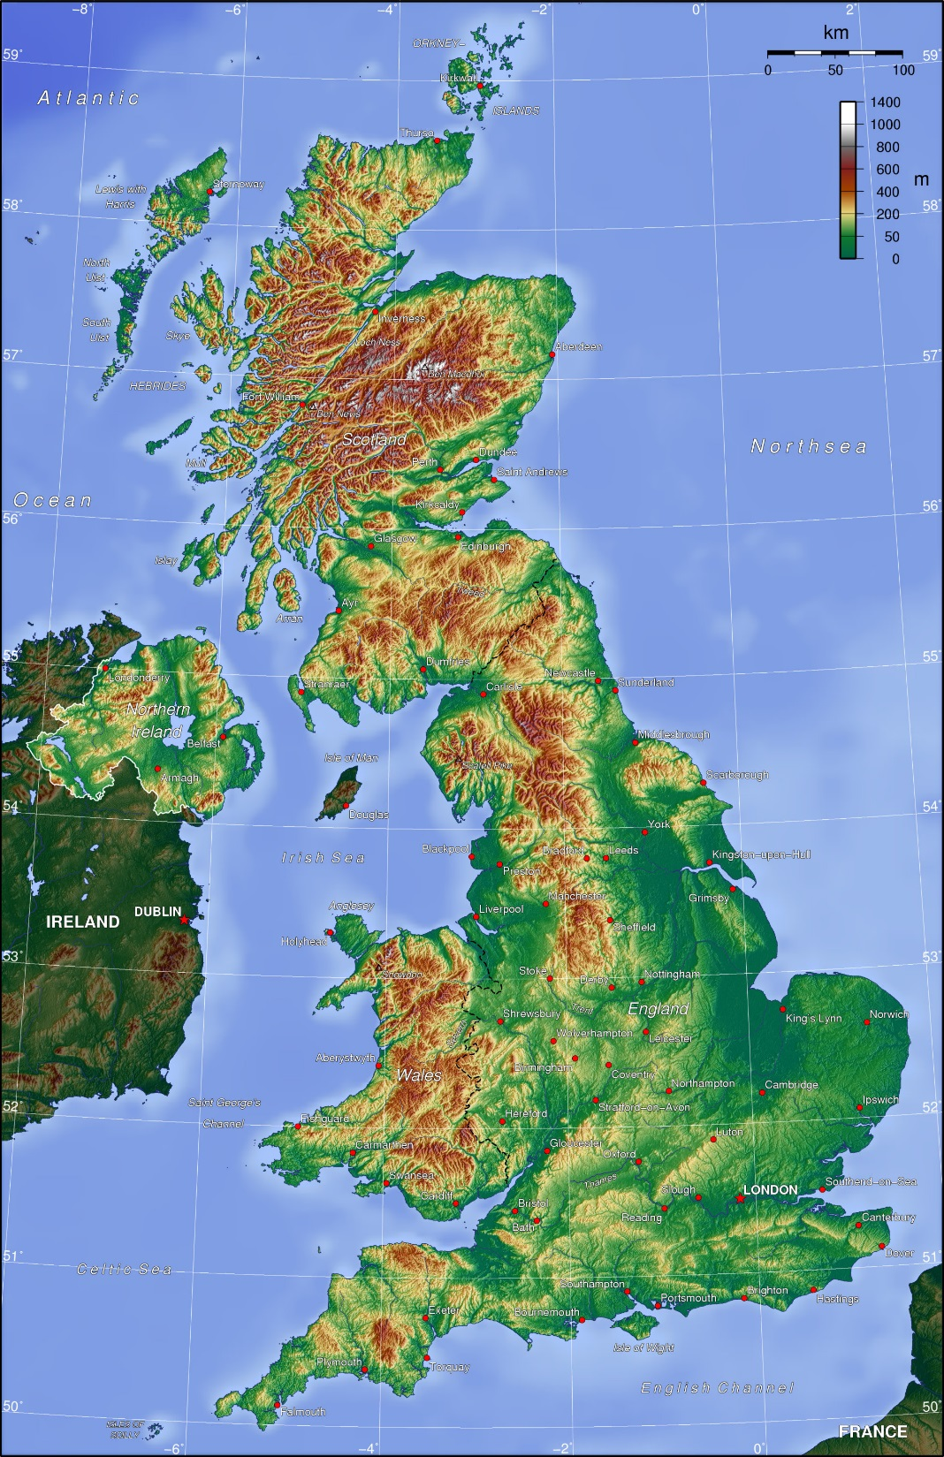
Act 3, scenes 1 and 2
Contending – fighting, arguing
The elements – the weather
Unbonneted – not wearing any hat
I am more than my out-wall – I am not just pretending
Cleaving – cutting in two
Rotundity – roundness
Alack – how sad
Hovel – tiny house
Albany
Britain
Dover
Cornwall
Kent tells the gentleman that a French army has landed secretly at Dover. Cordelia is married to the King of France, and this army has come to help her.

Slide 3
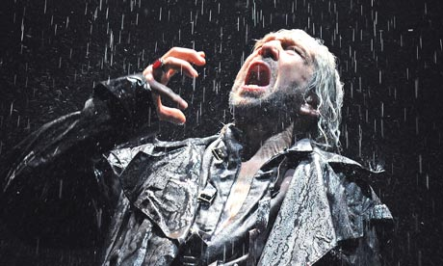
Summary
3:3 – Gloucester tells Edmund about the secret French army, and says he wants to join it.
3:4 – Lear meets Edgar, AKA “Tom O’Bedlam”.
3:5 –Edmund tells Cornwall (Regan’s husband) about Gloucester’s plan.
Vocab
Desired their leave – asked their permission
A power already footed – an army ready
The foul fiend – the devil
What hast thou been? – what job did you used to have?

Slide 4
Homework: Answer these 3 questions
3:3
Imagine you are Gloucester. Write a brief note to your friend explaining the situation you’re in.
3:4
Why does Lear prefer to endure the storm rather than seek shelter in the hovel? Refer to the text of the play in explaining your answer.
3:5
When Edmund tells Cornwall of the difficulty he has in betraying his father, what impression is he trying to create?

Slide 5
Previously on King Lear:
Gloucester decided to go and help Lear, and to go join the secret French army which Cordelia has sent to Dover.
His son Edmund immediately ratted him out to the Duke of Cornwall.
Lear met a crazed man named Tom and became his best friend. Tom is Edgar in disguise.

Slide 6
Vocab:
Yeoman – Commoner
‘em – in this scene Lear is ranting about his daughters
Arraign – put on trial
I took you for – I thought you were
Counterfeiting – faking
Conveyed him hence – brought him away
Five-or-six-and-thirty – 35 or 36
Confederacy – friendship
Lustre –shininess
Thrust - throw
Act 3 scene 6
Gloucester
Kent
Lear
Fool
Edgar
Act 3 scene 7
Cornwall
Regan
Goneril
Oswald
Servant 1
Servant 2
Servant 3
Gloucester

Slide 7
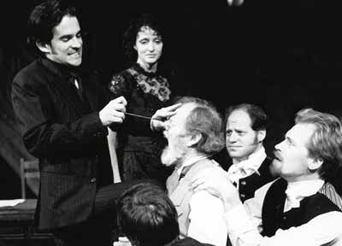
Why are Goneril, Regan and Cornwall so angry with Gloucester?
What impressions of human nature are conveyed in this scene? (Think about all characters, including the servants). Refer to the text of the play in your answer.
Trace the role Regan plays in this scene. What more do we learn about her character?
Imagine you are a props manager for a production of King Lear. Make a list of the items needed for this scene.

Slide 8


