Slide 1
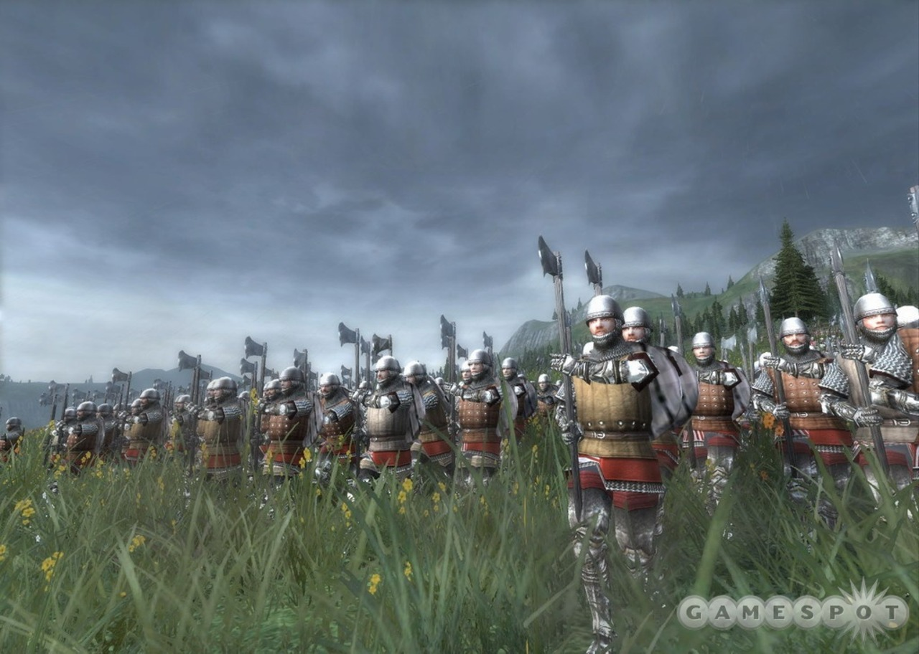
King Lear
Act 4

Slide 2
Act 4, scene 1
Edgar, in disguise, meets his dad Gloucester. He thinks about luck, fate and fortune.
Edgar, Old Man, Gloucester
Act 4 scene 2
Albany and his wife Goneril have a massive argument.
Goneril, Oswald, Edmund, Albany, Messenger
Vocab:
Esperance – hope
Lamentable – sad
Mutations – changes
Wanton - careless

Slide 3
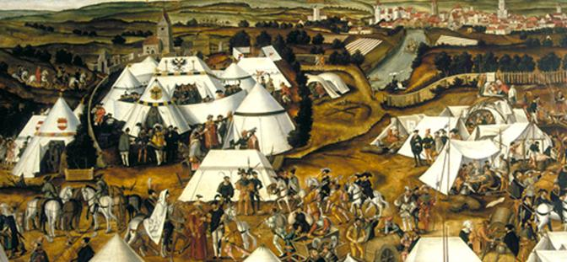
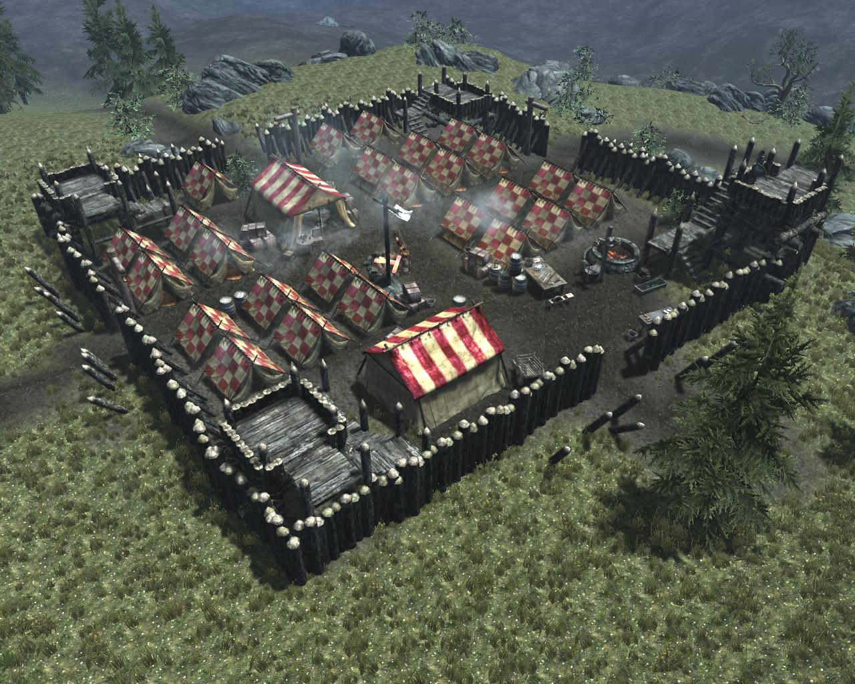
Act 4, scenes 3, 4 and 5
Act 4:3 – Kent reaches the French camp near Dover. He asks for news from one of Lear’s knights.
Act 4:4 – Cordelia, at the camp, worries about Lear, who is very ill.
Act 4:5 – Regan is jealous of Goneril and Edmund.

Slide 4
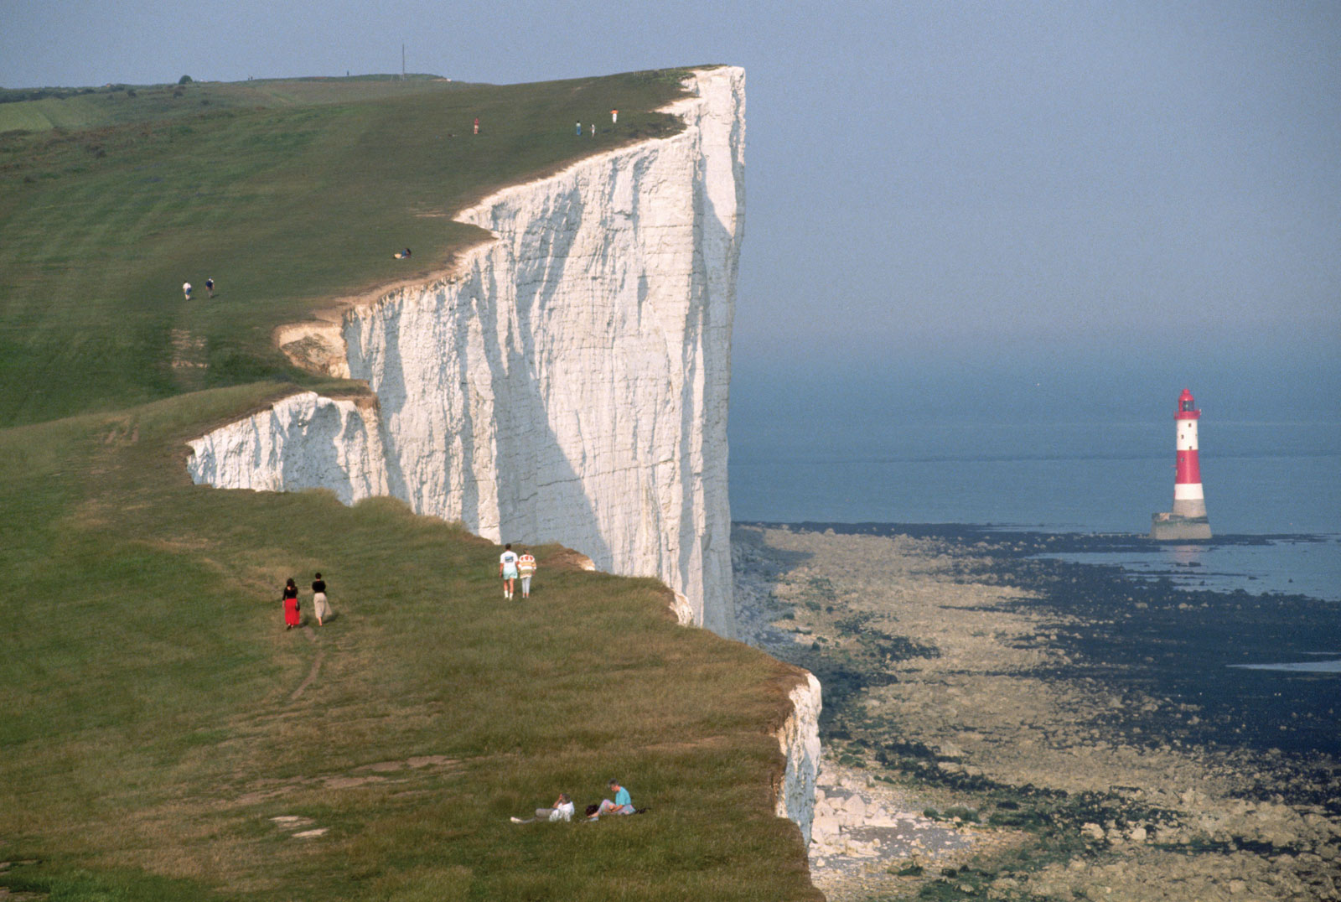
Act 4 scene 6
Cloucester and Edgar arrive at the cliffs of Dover.
They meet Lear.
Oswald, servant of Goneril, attacks.

Slide 5
Methinks – I think
Garments – clothes
Choughs – a bird, pronounced “chuffs”
Gross – big
Bark – ship
Cock – small boat
The extreme verge – the edge
Renounce – throw away
So many fathom down precipitating – falling such a huge distance
Thoud’st shivered – you would have smashed
Lecher – copulate
Beneath the girdle – from the waist down
Beadle – an official like a cop
Matter and impertinency mixed – what he says is partly crazy, partly sane
Jovial – merry
A battle toward – a battle happening soon

Slide 6
Lear’s development as a character
1: Dividing his kingdom. Strong, full of authority and confidence. “Come not between the dragon and his wrath”.
2: His daughters defy him. Frustrated, angry, still powerful. “Ingratitude… more hideous when thou show’st thee in a child than the sea-monster!”
3: Raging at the storm, powerless, vulnerable, defiant. “All-shaking thunder, strike flat the thick rotundity o’th’world”.
4: Rambling senselessly, “Reason in madness”, more humble and modest than before. (Speeches in Act 4 scene 6).

Slide 7
Thinking critically about Lear
“Lear steps down from his throne but expects everyone to continue treating him as a king. He does not see that other people will take advantage of his weakness; also that those who flatter him the most grossly are exactly those who will turn against him. When he finds that he can no longer make people obey him as they did, he falls into a rage which is perfectly in character.”
“He has gotten rid of his kingship; free from it, how the natural genius of the man begins to show! It flashes on us as the last outbursts of some near-extinct volcano. He is old and uncertain, but a mighty man, never simply a tyrant with his power taken away. He has genius, warped and random genius, very close to madness.”
George Orwell
H Granville-Barker
Which do you agree with more, and why?

Slide 8
Act 4: 7
Weeds – clothes
I’th’sway of – under the control of
Had not concluded all – Had not died
Abused – tricked
Benediction – blessing
Fourscore – 4 x 20 = 80

Slide 9

I do not own any of the images in this slide show.
For more teaching resources, check out

