Slide 1
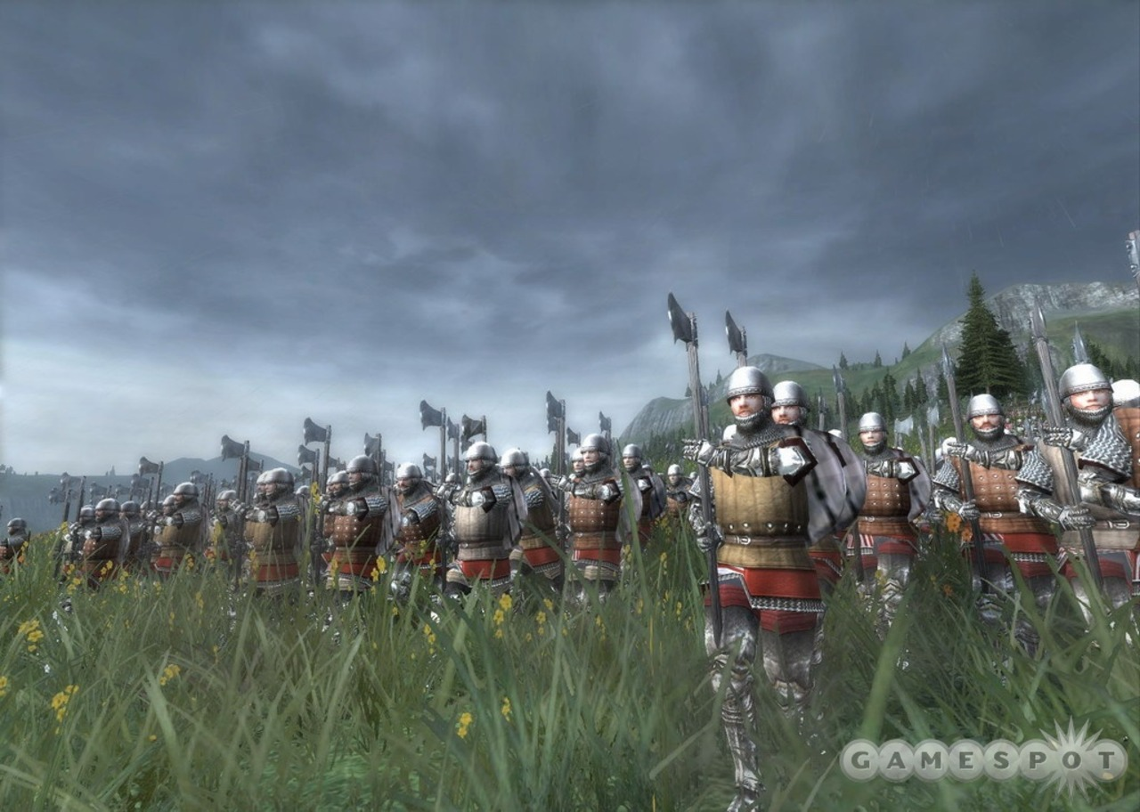
King Lear
Act 5

Slide 2
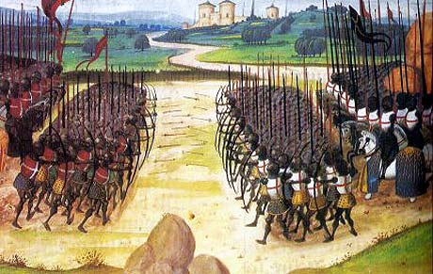
The Battle
A French army
Kent
Cordelia
Edgar
Some of Lear’s knights
The Fool (?)
Lear
Gloucester
Regan
Goneril
Albany
Albany’s army
Edmund
Cornwall’s army
Edgar took from Oswald’s body a letter proving that Goneril plans to kill Albany.
Vocab:
Alteration and self-reproving – changing his mind
In honoured love – I love her as a friend
I know the riddle – I see what you’re trying to do
Ta’en – taken prisoner

Slide 3
“Lear tries to be strong and full of authority through his position as king and father. However, he only wins the admiration of the audience through suffering and being reduced to misery.”
Write 2 paragraphs agreeing or disagreeing with this statement.
Write on an a4 page so that you can hand it up.
Include 2 or 3 quotes from the text to back up your point.

Slide 4
Act 5, scene 3: take down vocab
Cast
Lear
Cordelia
Kent
Edgar
Albany
Edmund
Goneril
Regan
Gilded butterflies – people in fancy clothes
Brand – burning torch
Thrive by other means – find a different job
The opposites of this day’s strife – our enemies in this battle
Ere – before
In thy attaint – with you
Herald – messenger
Maugre – despite
Cozened and beguiled – fooled

Slide 5
Reflecting on the final scene
Act 5 Scene 3 is full of dramatic turn-arounds.
At the start of the scene it looks as though Goneril, Regan and Edmund have completely won.
Then Albany and Edgar challenge Edmund, and Goneril and Regan’s rivalry reaches new levels of deadliness.
Just when things are looking good for Lear and his friends, a tragic and avoidable death adds a bitter note to the play’s ending.

Slide 6
Homework:
Does King Lear have a happy ending or a sad ending? Explain your answer.

Slide 7

I do not own any of the images in this slide show.
For more teaching resources, check out

